Slide 1
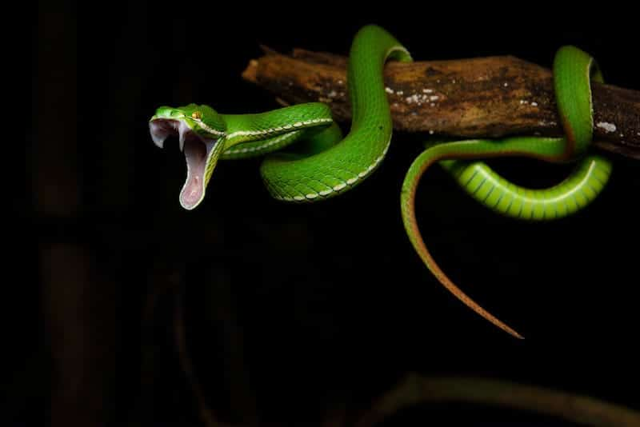
Project: cobra
~Software to help snakebite victims
This Photo by Unknown Author is licensed under CC BY-SA-NC

Slide 2
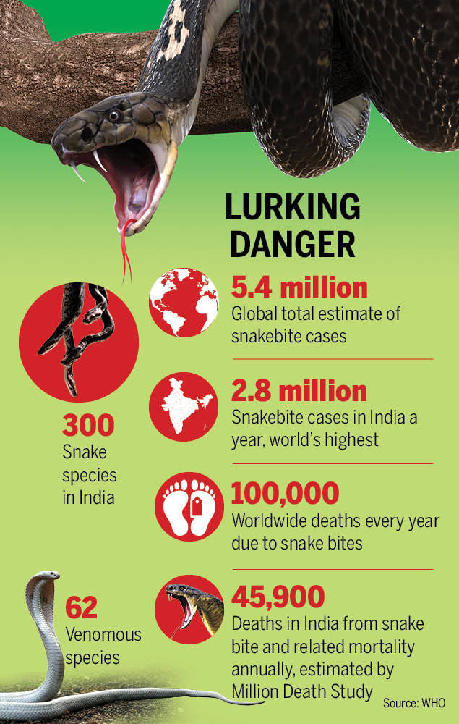
Why we choose this problem?
Snake bite leads to approximately 58,000 people died in India every year.
India alone accounts for about 2.8 millions snake bites cases annually which is the highest in the world.
About there are 62 venomous species of snakes are found in india. And most cases of death are occurred in Uttar Pradesh, Bihar, West Bengal etc.
According to report of Times of India only 10% cases of snakebites are recorded.
Snakebite death cause is among top 20 death causes in India.
In rural areas hospitals are at large distance from villages which cause most death problems
In villages there are some people who promises to cure victim but they fail.

Slide 3

Our solution:
We are creating a software which will focus on snakebite issues in rural areas.
User have 2 options for connecting to our services, that are by IVR call or by using software.
Both options will take location access of user and ask details by which we can predict about snake and time of snakebite.
Our software will send precautions and guidelines to user.
Our software will monitor the availability of antivenom in nearest government/district hospitals.
Software will take out the shortest and fastest path between victim and hospital which have antivenom.
Software will check can victim reach hospital on time or not, if yes then it will give directions, but if no then it will take out a mid point where both victim and ambulance with antivenom can reach and victim can get treated on time.
Our software will give direction to ambulance and victim of that mid point and will convince hospital to provide ambulance service.

Slide 4
FLOWCHART:
user
IVR call
asking
details
guidelines
software
access of location
antivenom
availability
shortest & fastest path to antivenom
travel time from location to antivenom
Hospitals
district/government
Can victim reach on time?
yes
no
will take out point where victim can get treated on time
Will give them directions of shortest path
Ask ambulance to reach that point

Slide 5
How our solution is different:
SARPA is a software available in market and this software is only for study purpose like awareing people and our software is very different as our software provides facilities for rural areas like IVR call and on ground antivenom if victim cannot reach hospital on time and also give directions for how can victim reach to antivenom on time.
NAPSE is also a software available in market and it provides education to people related to snakes and snakebites and our software is very different from that as our solution is providing additional facilities like providing antivenom on time so that victim can be cured on time, and connecting victim to hospital easily.
There are few more solutions available for this problem which are available but they are only providing awareness and education but our solution will work to help victim after snakebite like giving guidelines related to what to do after bite from a snake species, and will help victim to reach either hospital on time by giving directions or by taking out mid point and providing ambulance service there.

Slide 6
Team details:
Narayan Bhardwaj
~team leader
KARTAVYA CHAUHAN
~founder
SUDHANSHU SHARMA
~co-head

